Slide 1
Image Alignment
Janghun Jo
Computer Graphics Lab.
jhjo432@postech.ac.kr

Slide 2
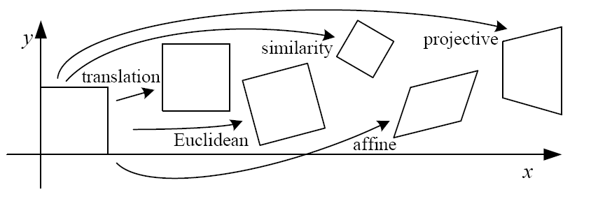
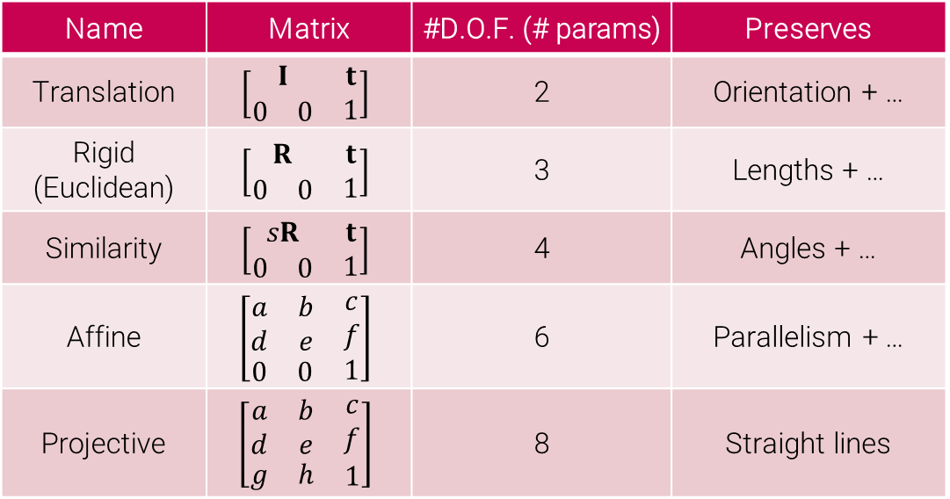
2D image transformations
Name | Matrix | #D.O.F. (# params) | Preserves
Translation | $$\left[\begin{matrix}I & t \\ \begin{matrix}0 & 0\end{matrix} & 1\end{matrix}\right]$$ | 2 | Orientation + …
Rigid (Euclidean) | $$\left[\begin{matrix}R & t \\ \begin{matrix}0 & 0\end{matrix} & 1\end{matrix}\right]$$ | 3 | Lengths + …
Similarity | $$\left[\begin{matrix}sR & t \\ \begin{matrix}0 & 0\end{matrix} & 1\end{matrix}\right]$$ | 4 | Angles + …
Affine | $$\left[\begin{matrix}\begin{matrix}a & b \\ d & e\end{matrix} & \begin{matrix}c \\ f\end{matrix} \\ \begin{matrix}0 & 0\end{matrix} & 1\end{matrix}\right]$$ | 6 | Parallelism + …
Projective | $$\left[\begin{matrix}\begin{matrix}a & b \\ d & e\end{matrix} & \begin{matrix}c \\ f\end{matrix} \\ \begin{matrix}g & h\end{matrix} & 1\end{matrix}\right]$$ | 8 | Straight lines

Slide 3
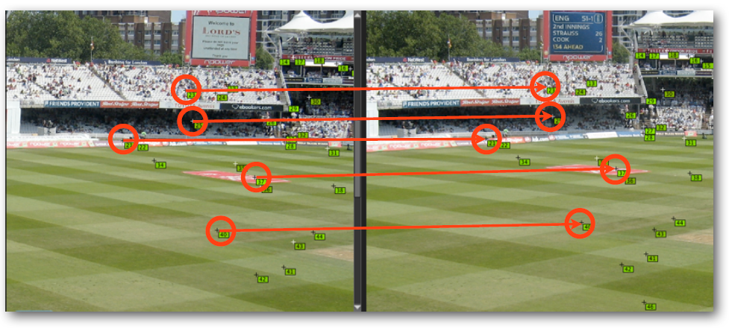
Feature-based alignment
Procedure
Find a few important feature points (a.k.a interest points)
Match them across two images
Compute image transformation from the matches (e.g., homography)
Notes:
In the following, we will study each step in more detail one by one.

Slide 4
Feature detection
Goal – Find points in an image that can be:
Found in other images
Found precisely – well localized
Found reliably – well matched

Slide 5
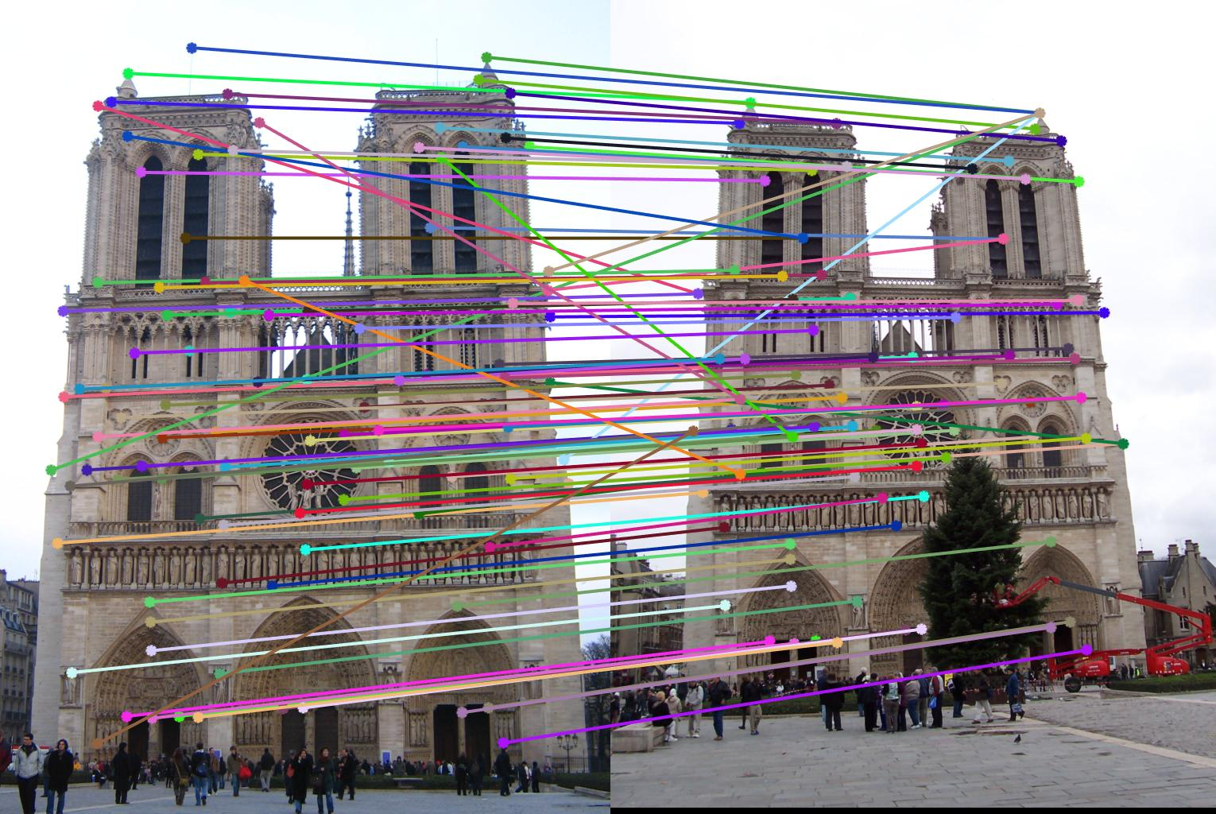
Feature matching
We have matches now.
Can we estimate a transformation now?
No. Because of outliers (wrongly matched pairs)

Slide 6
Outlier rejection
We have to exclude outliers from estimating a transformation
How?
RANSAC
RANdom SAmple Consensus
Most widely used outlier rejection method

Slide 7
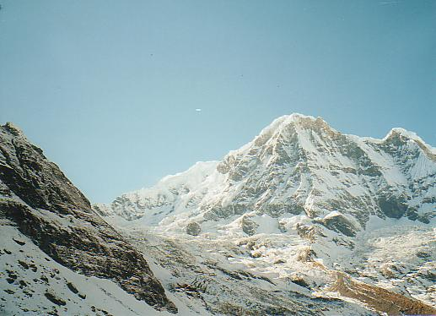
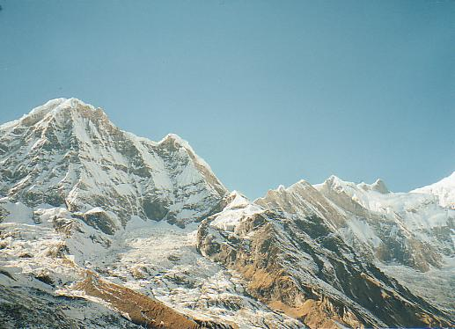
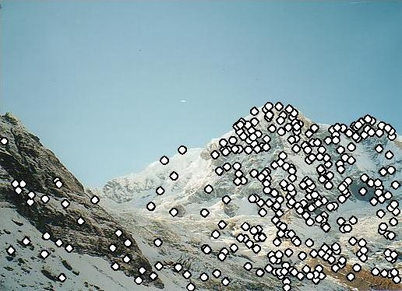
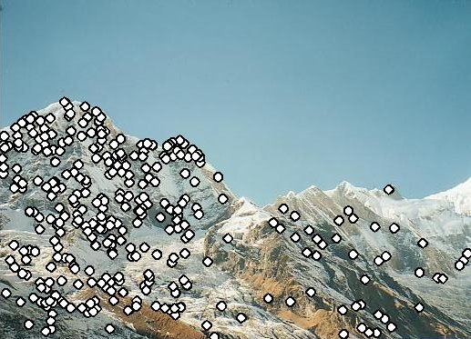
Example – feature detection

Slide 8
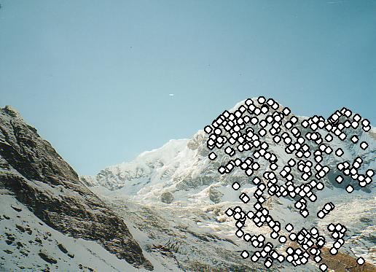
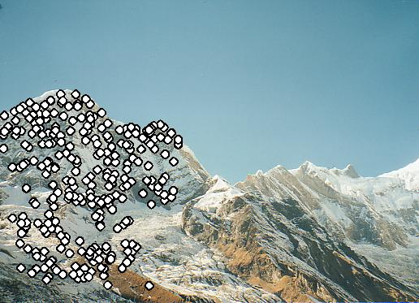
Example – feature matching & homography estimation using RANSAC

Slide 9
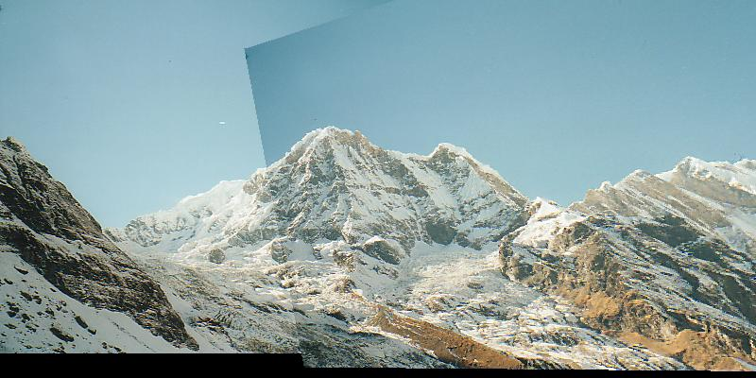
Example – align two images using estimated homography
How can we remove this seam?

